Slide 1
Dynamic Demand Modeling
Population Dislocation Models

Slide 2
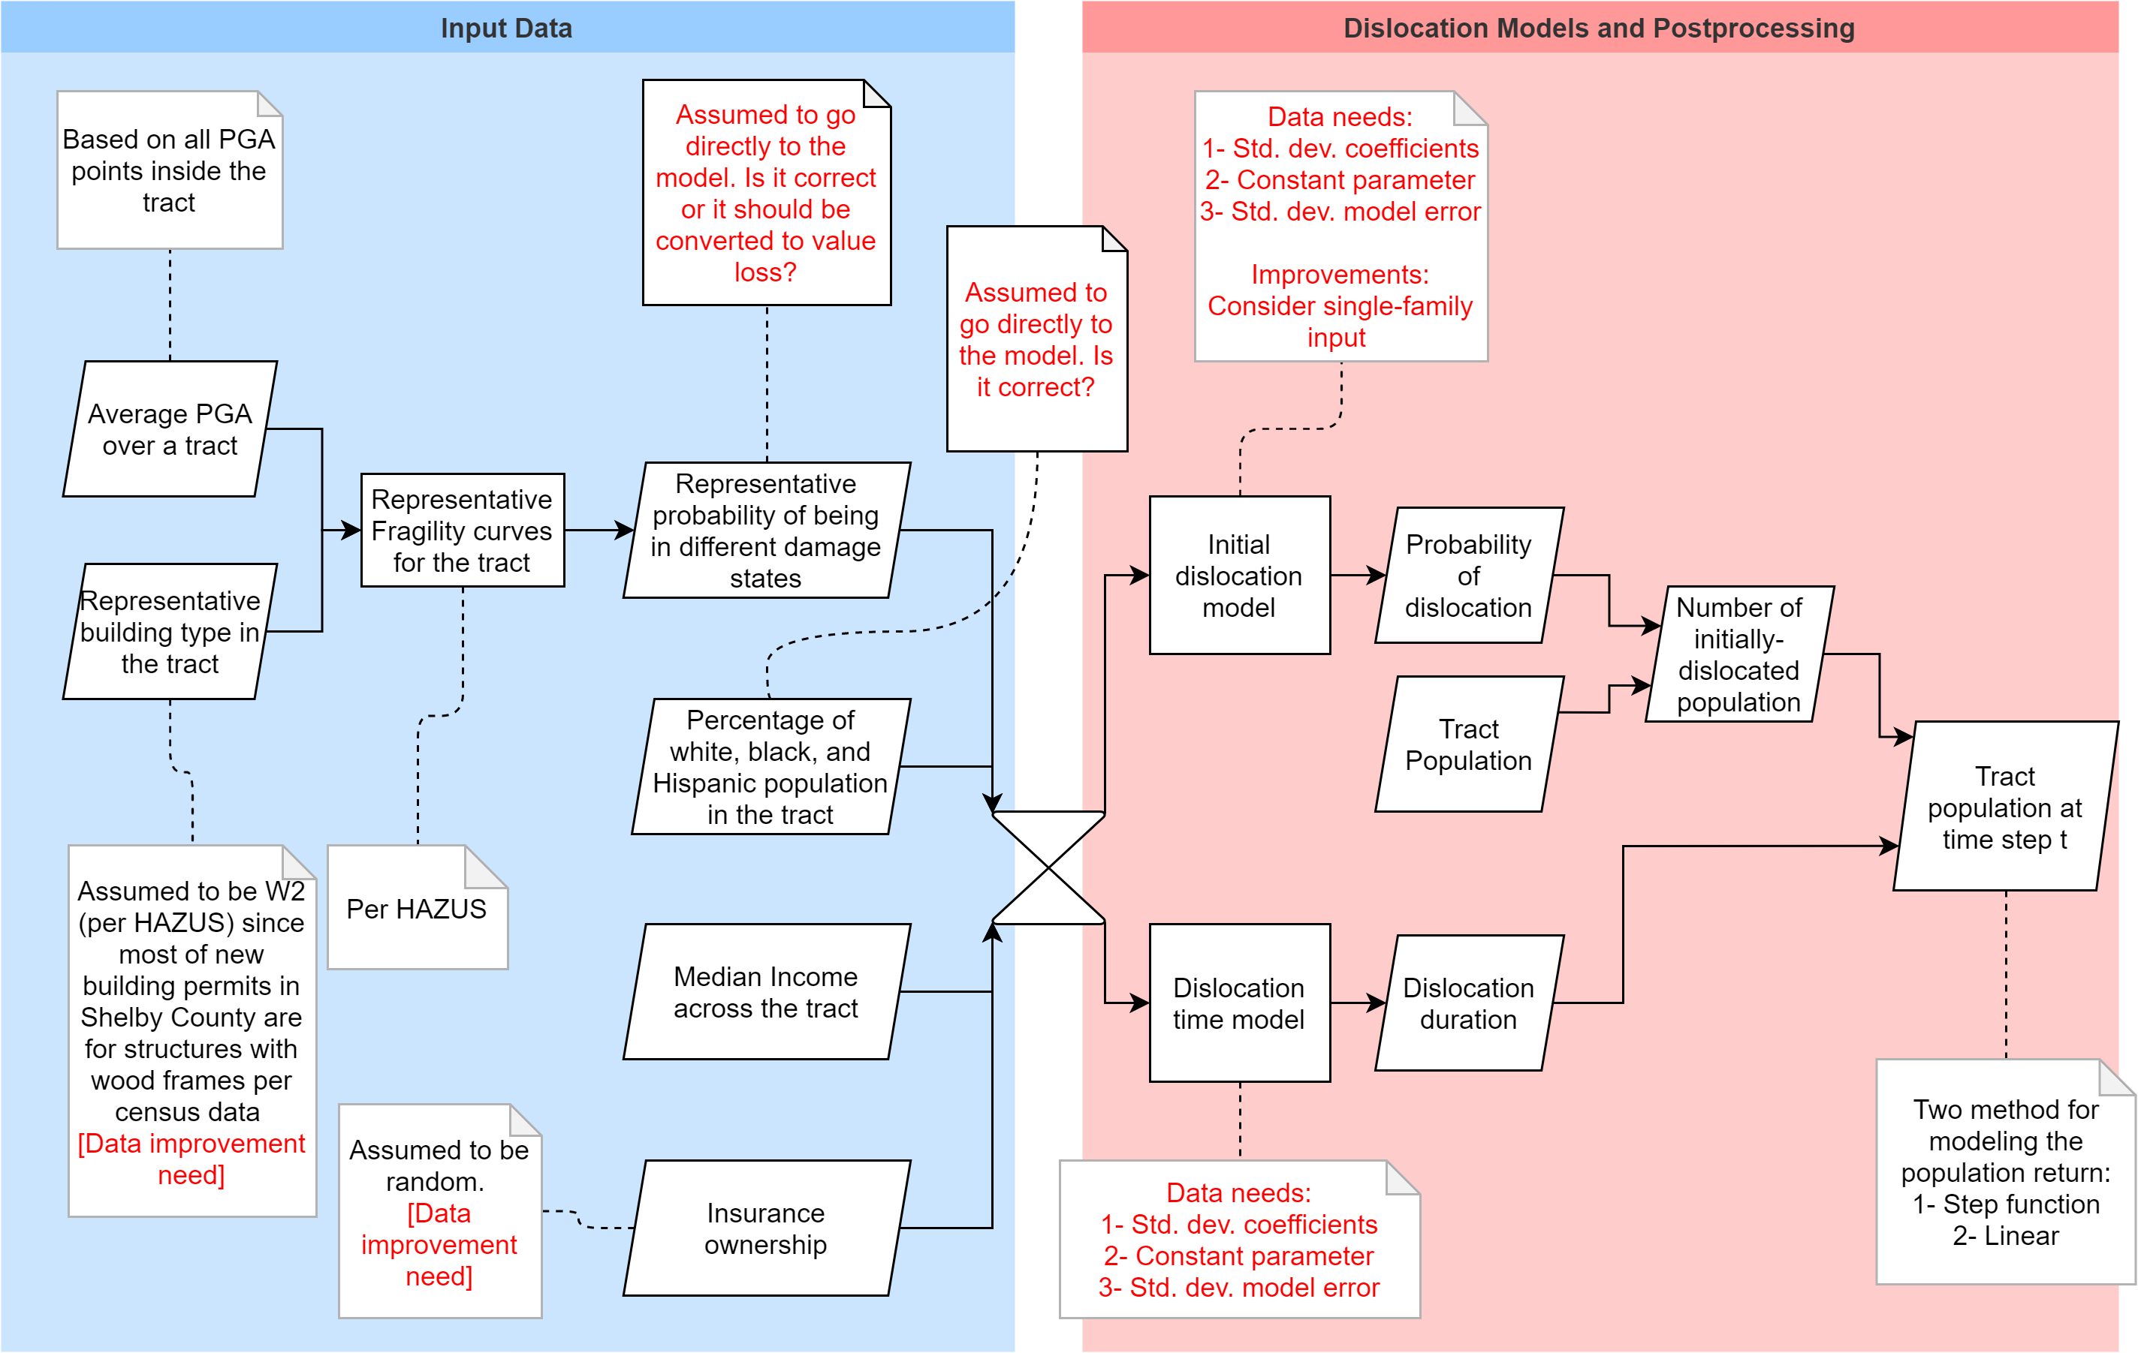
Flowchart
For each census tract
(red comments are
current data issues
or model ambiguities).

Slide 3
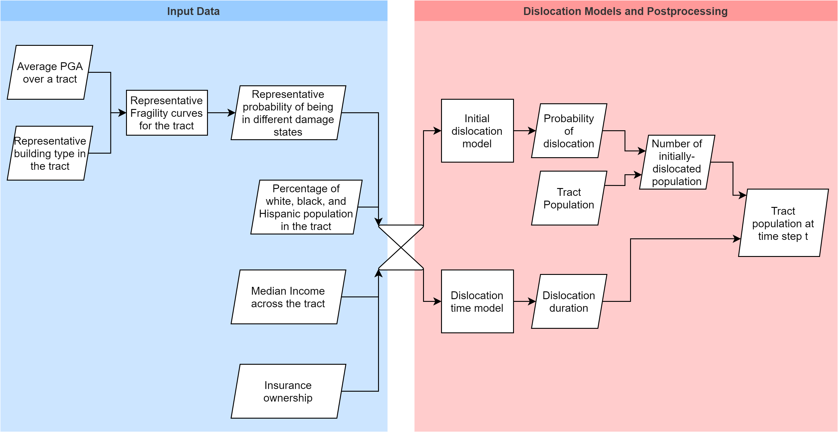
Flowchart (Core)

Slide 4
Main issues
Dislocation models are based on Lumberton data and we use them for Shelby County.
Dislocation models are based on hurricane data and we use them for seismic events.
Dislocation models are for individual households and we use them on the census-tract level.
Dislocation models have low prediction power.

Slide 5
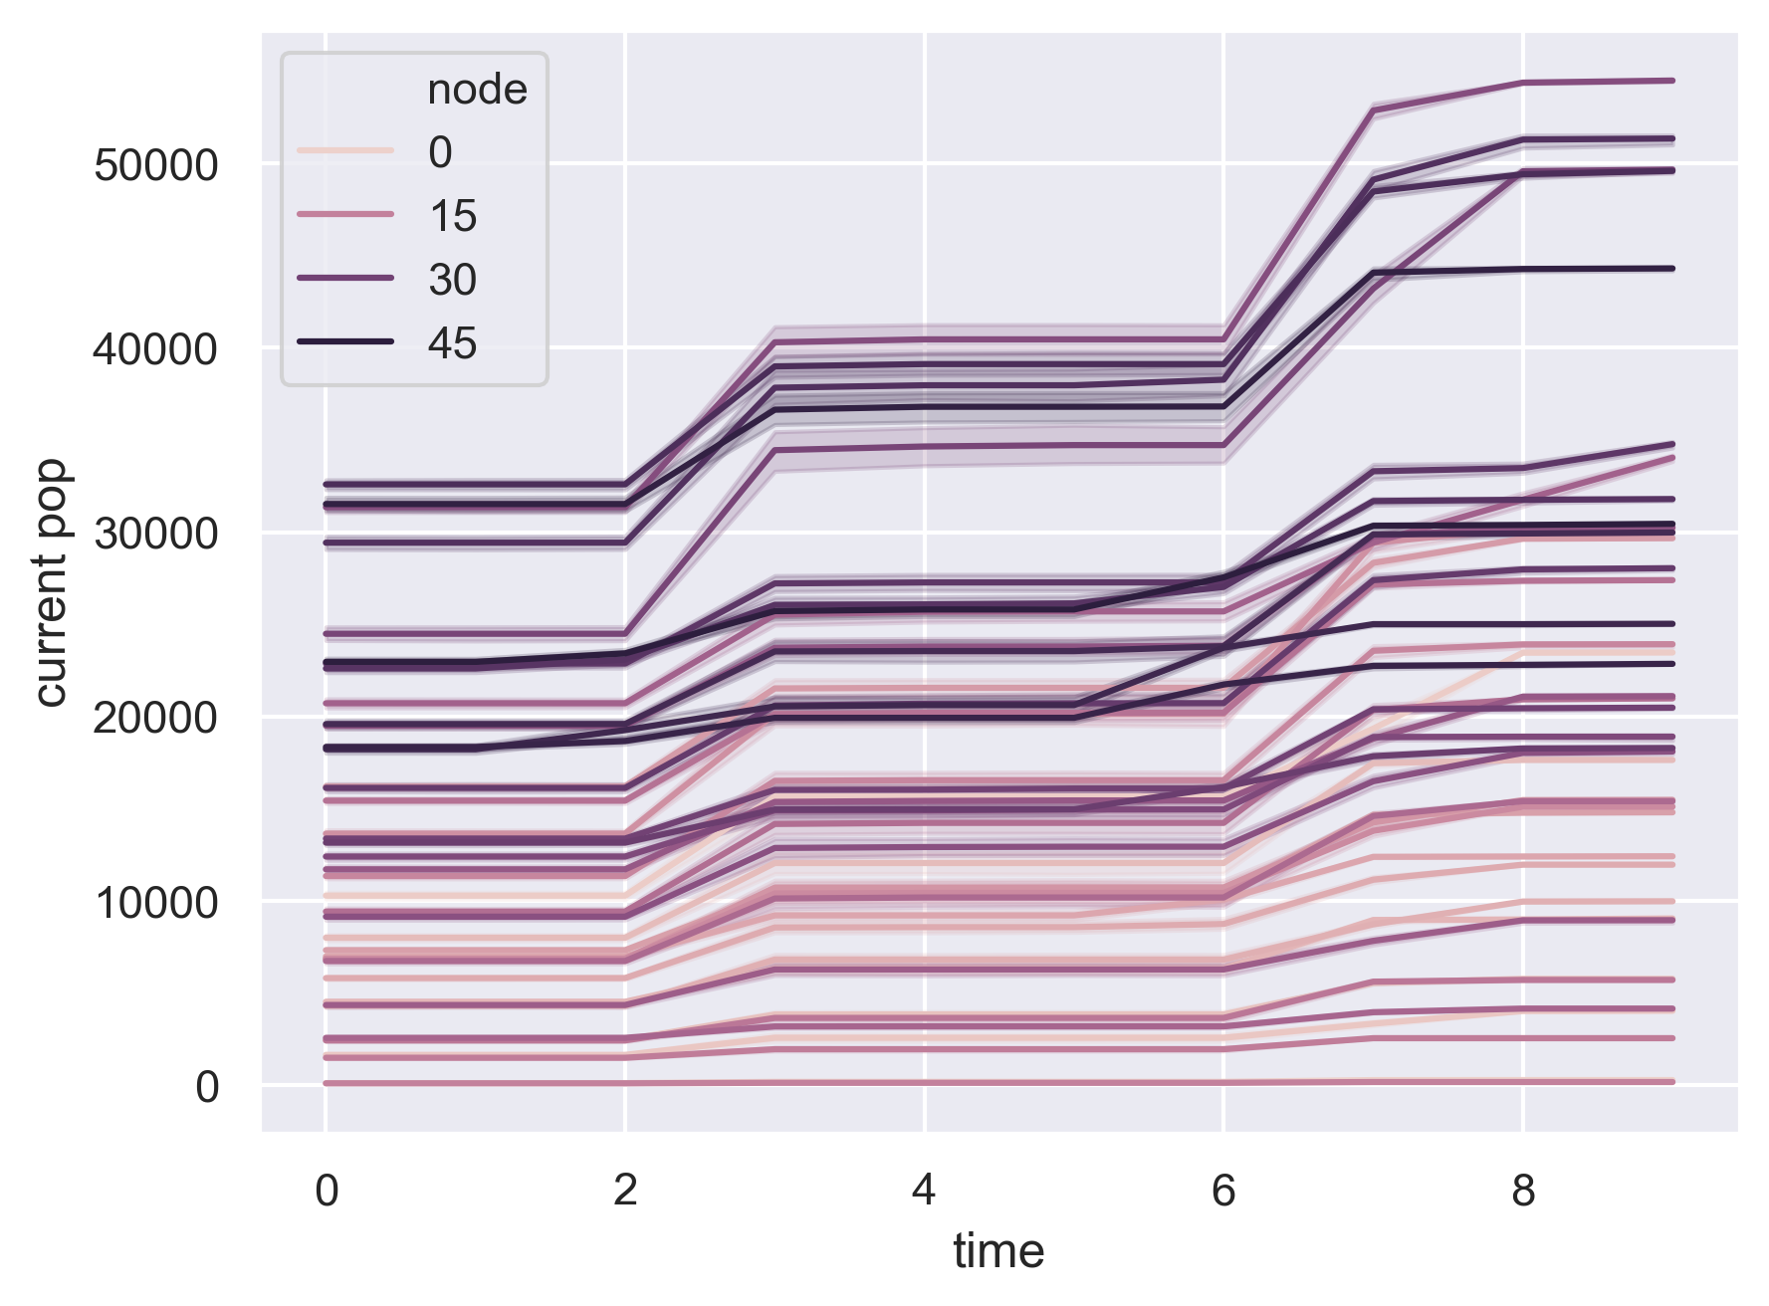
Demand trends (power net, step-function)

Slide 6
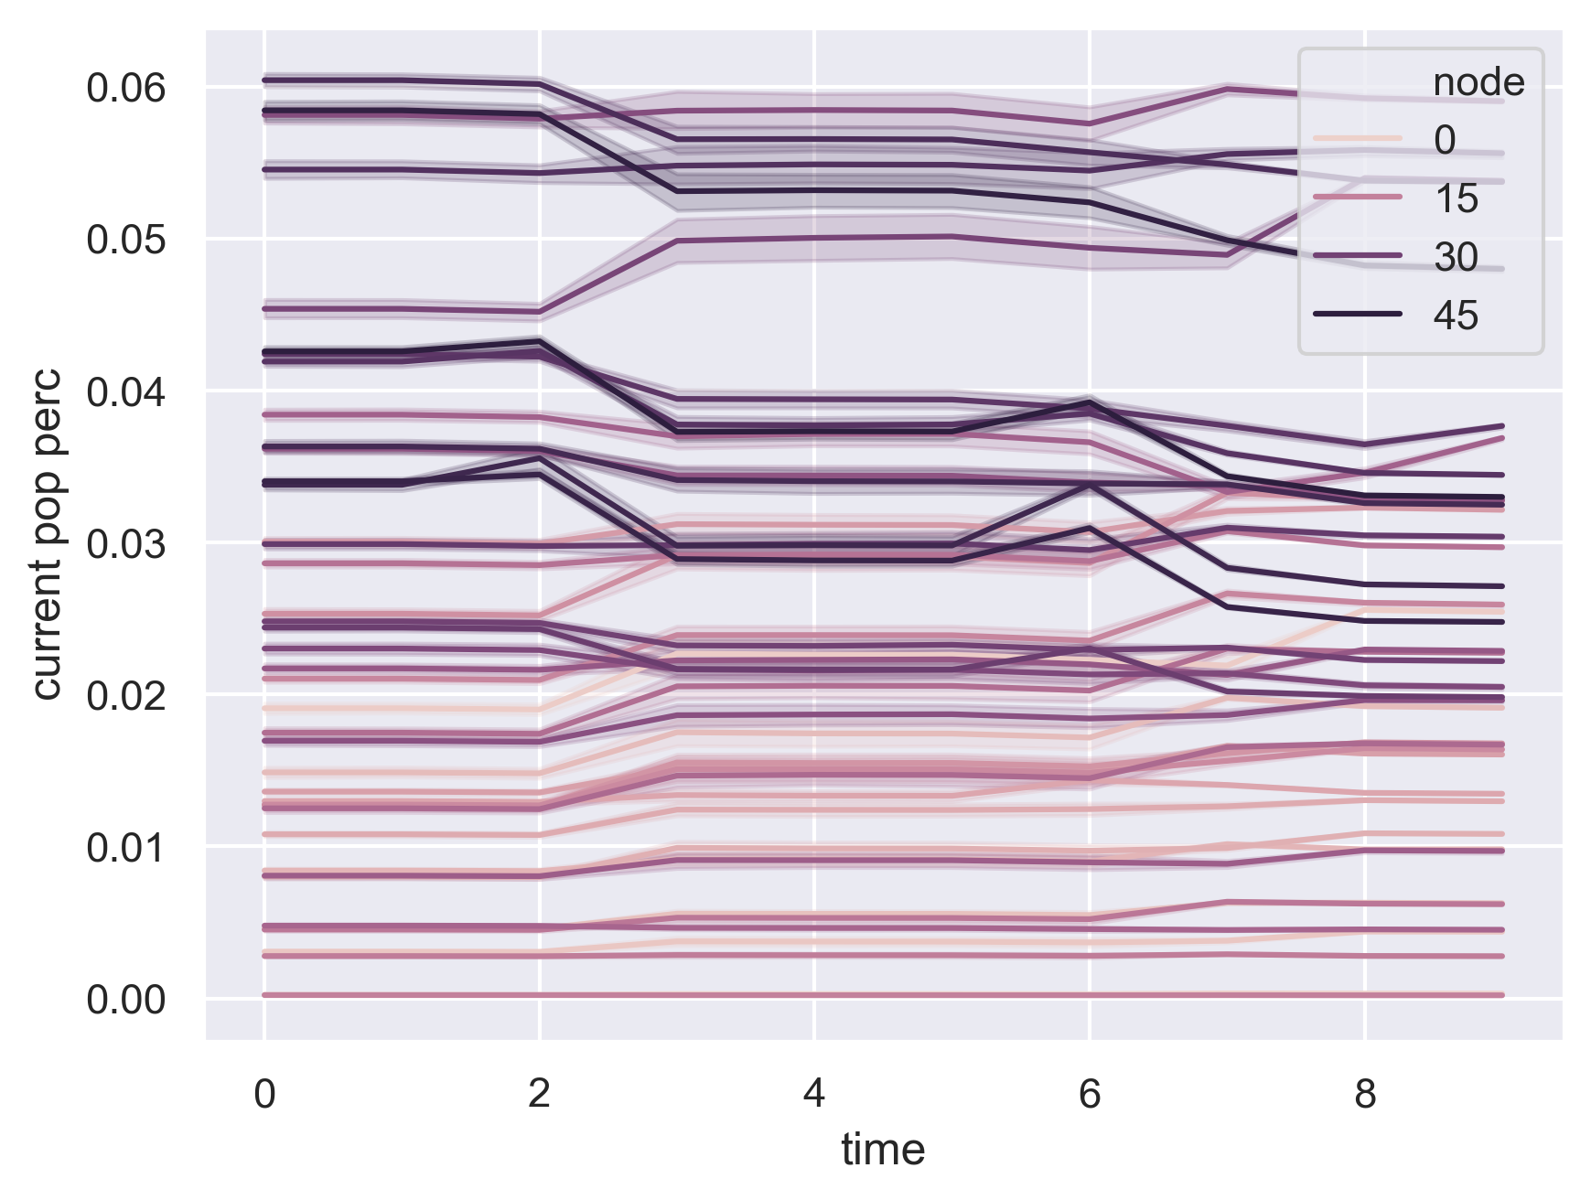
Demand trends (power net, step-function)

Slide 7
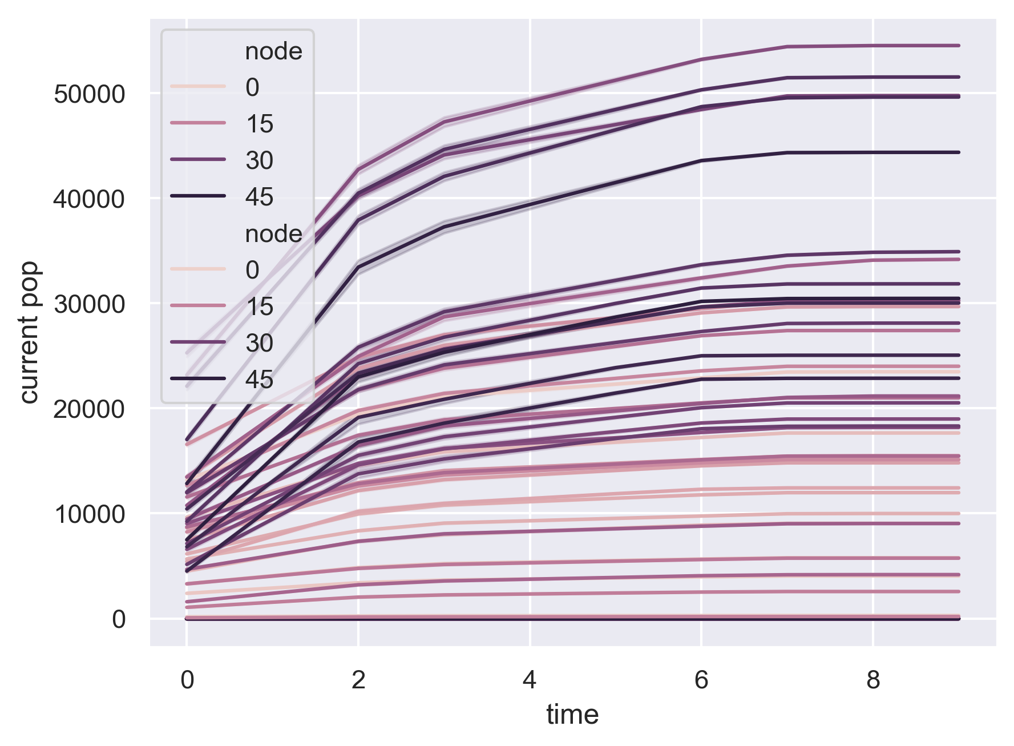
Demand trends (power net, linear)

Slide 8
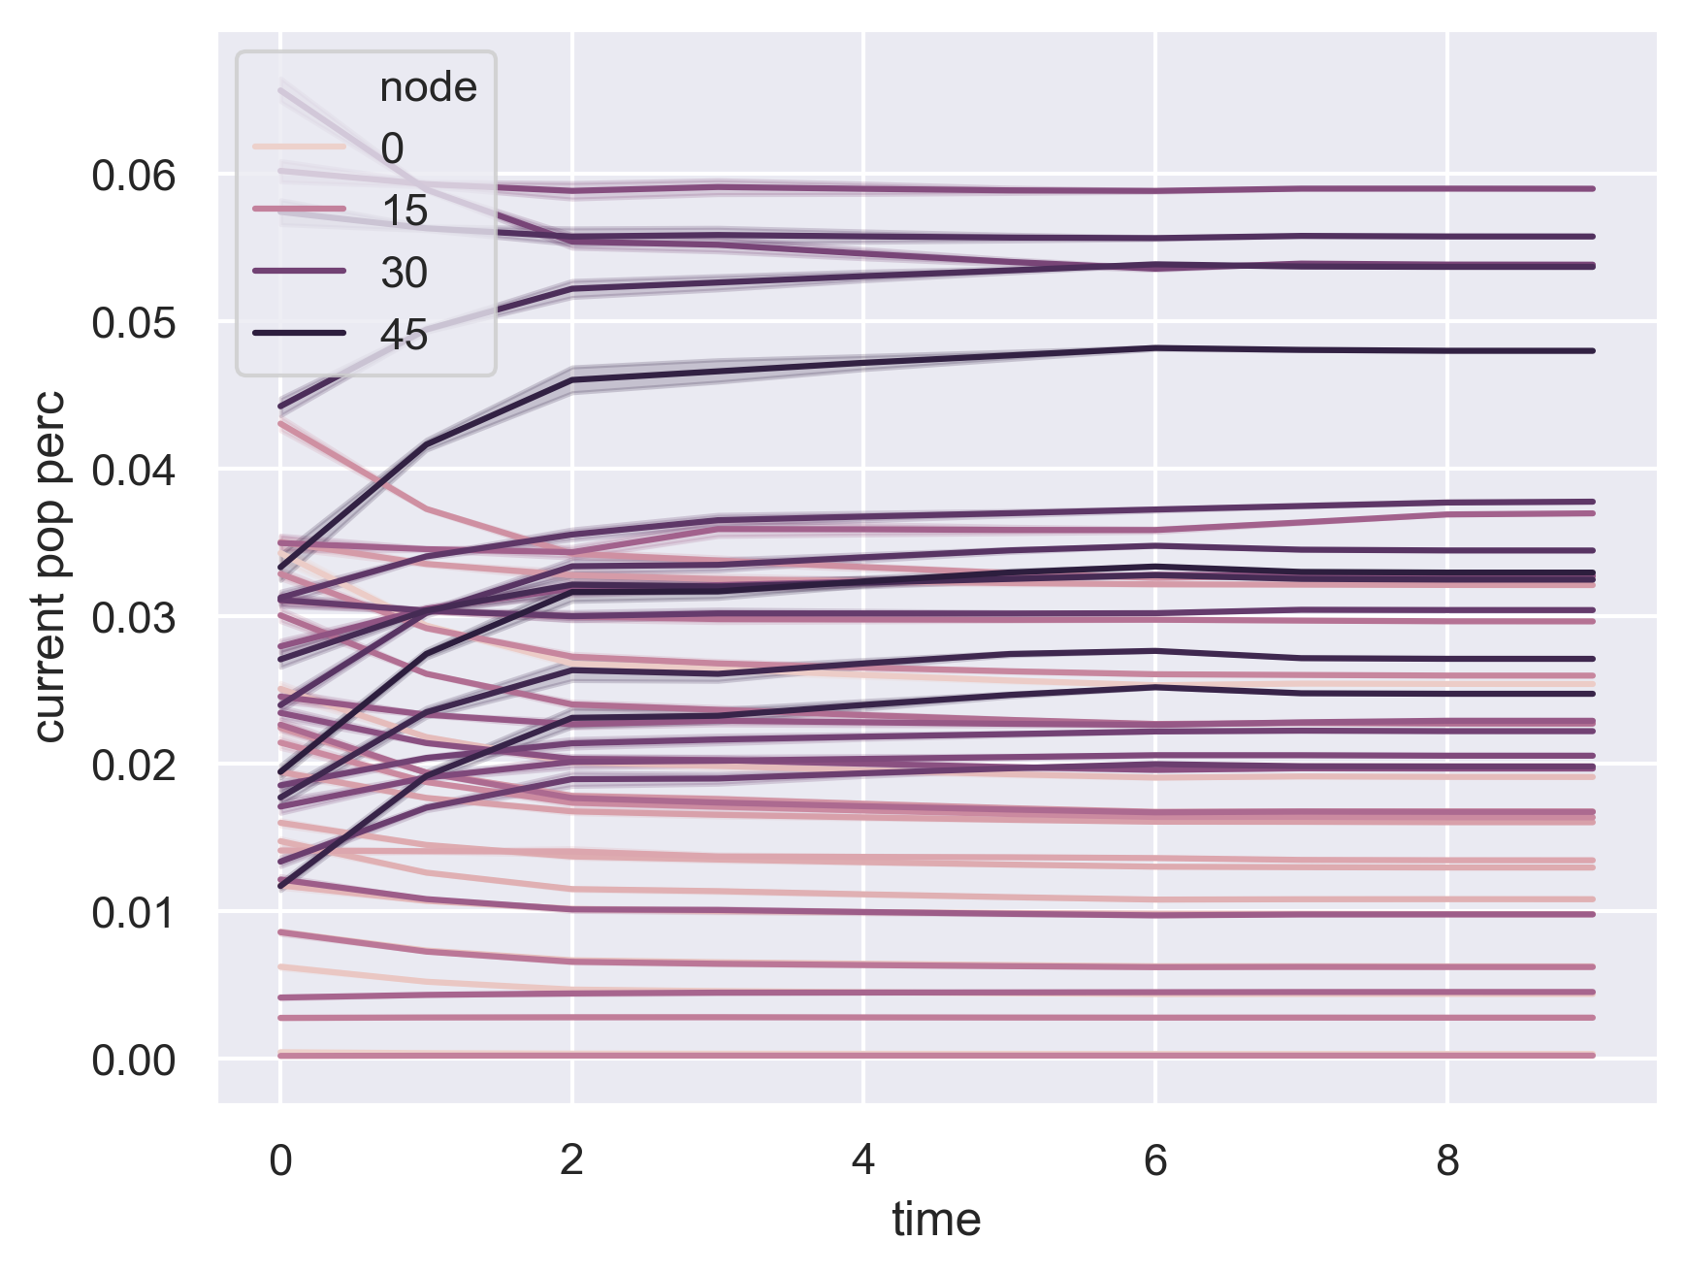
Demand trends (power net, linear)

Slide 9
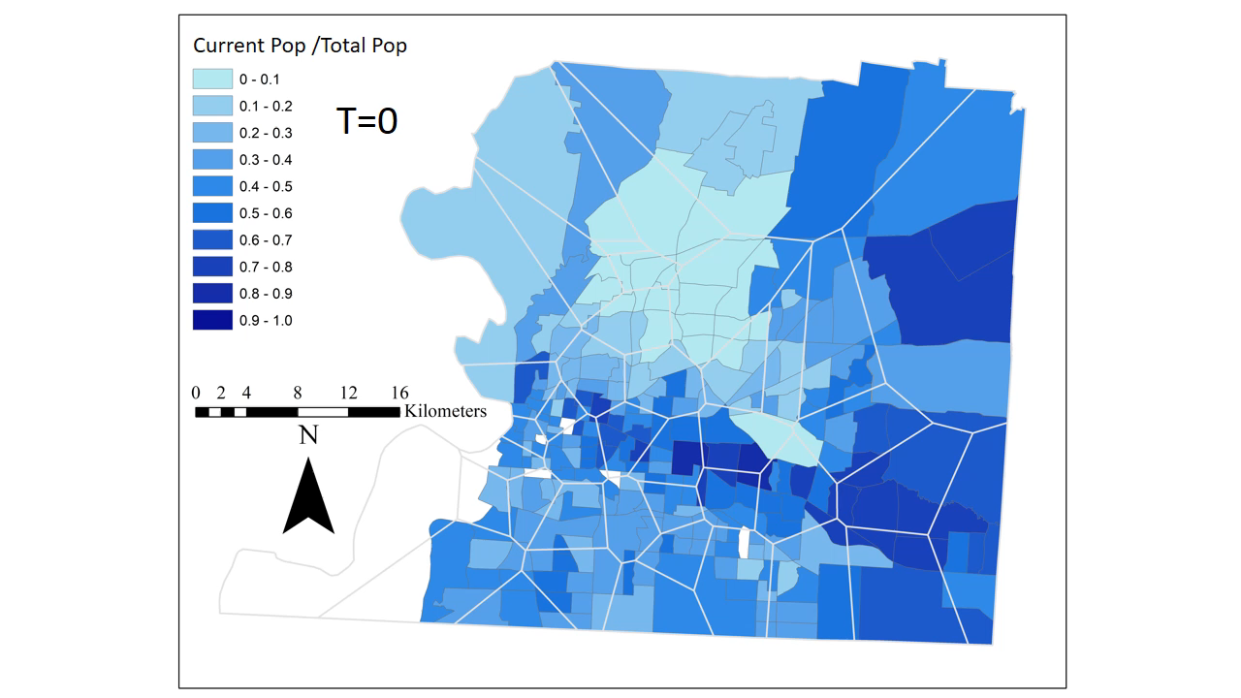
Population Trend (single scenario, step-function return)
Assuming that each time step is one week.
Initial dislocation probability across tracts
Range = 0.18 - 0.99
Mean = 0.61
Std. dev. = 0.19
Dislocation time across tracts
Range = 2.28- 42.38 weeks
Mean = 7.75 weeks
Std. dev. = 6.48

Slide 10
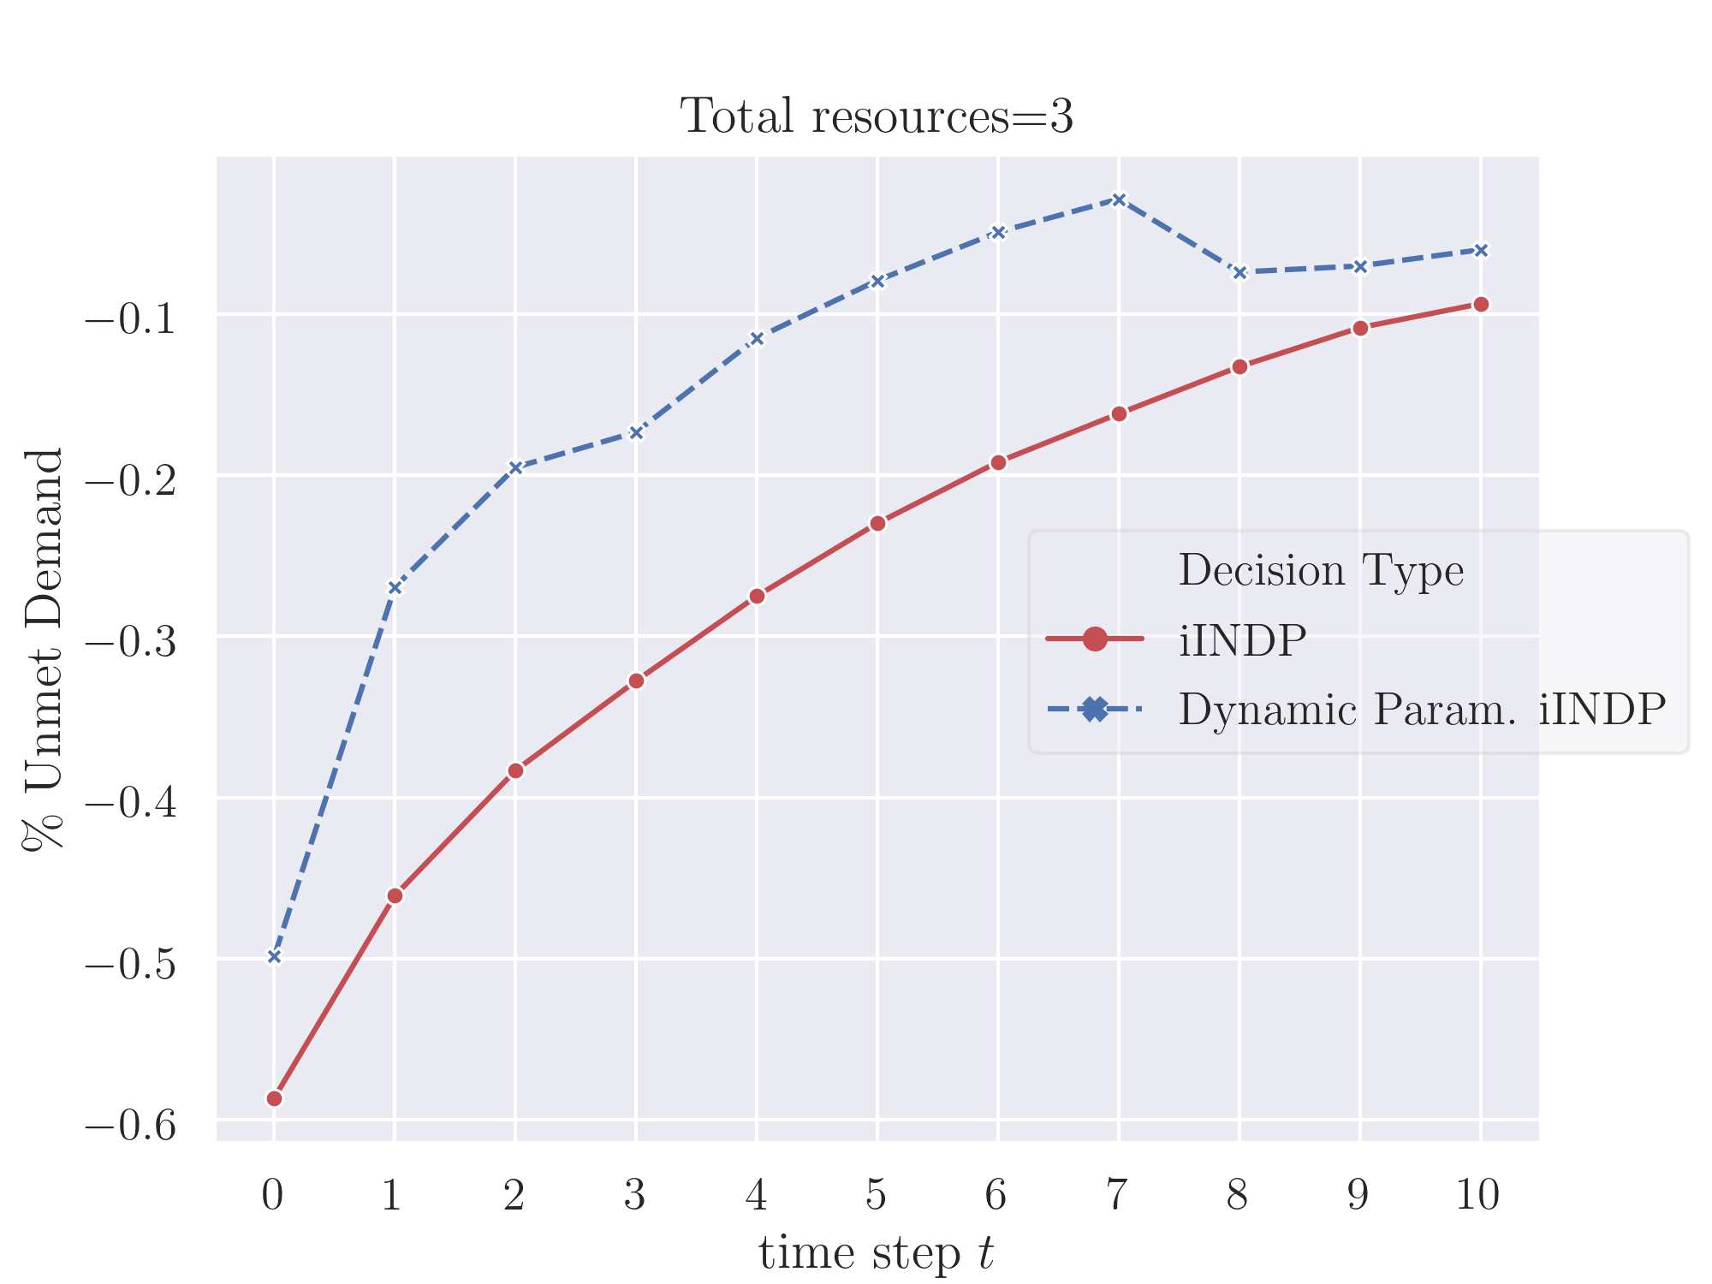
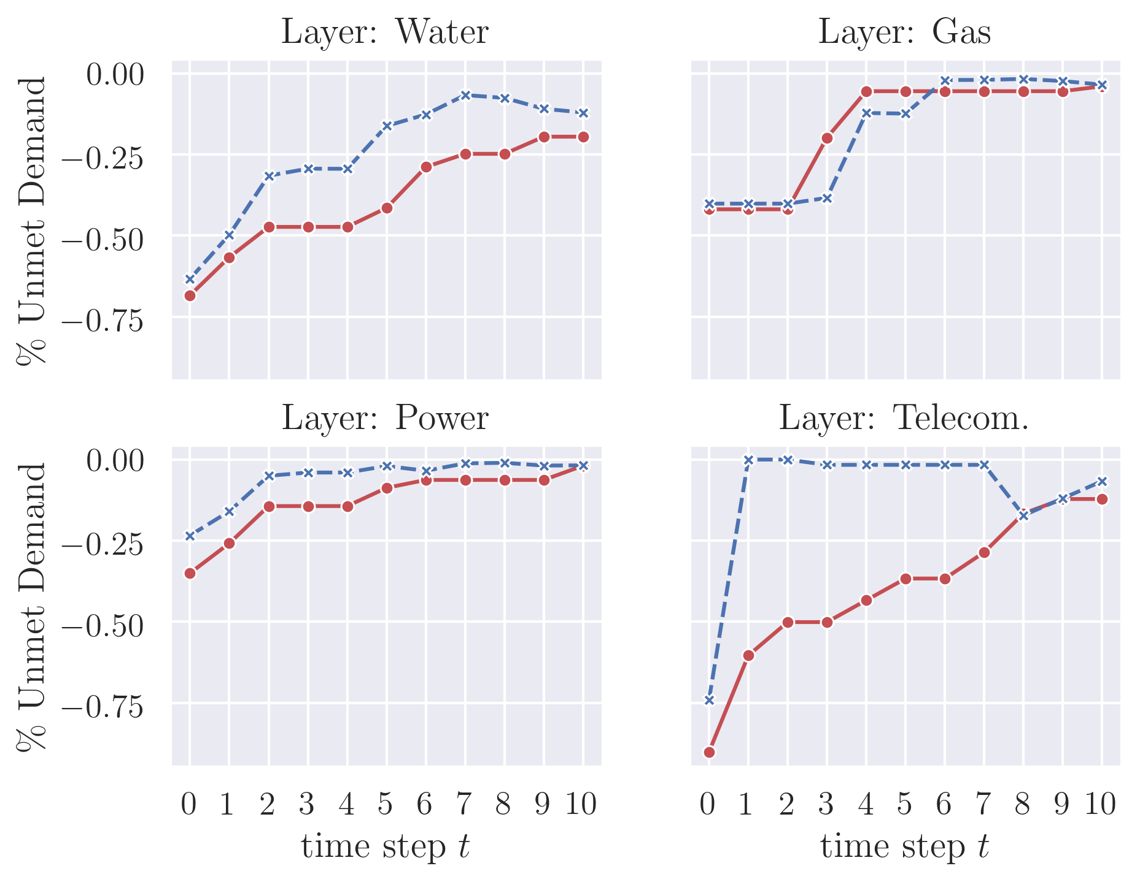
Restoration Resilience (single scenario, step-function return)

Slide 11
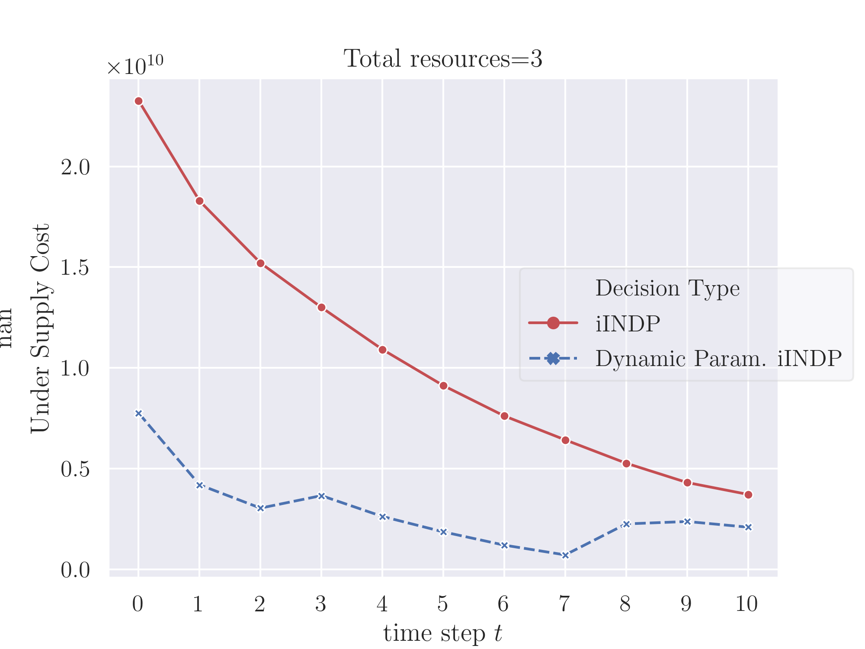
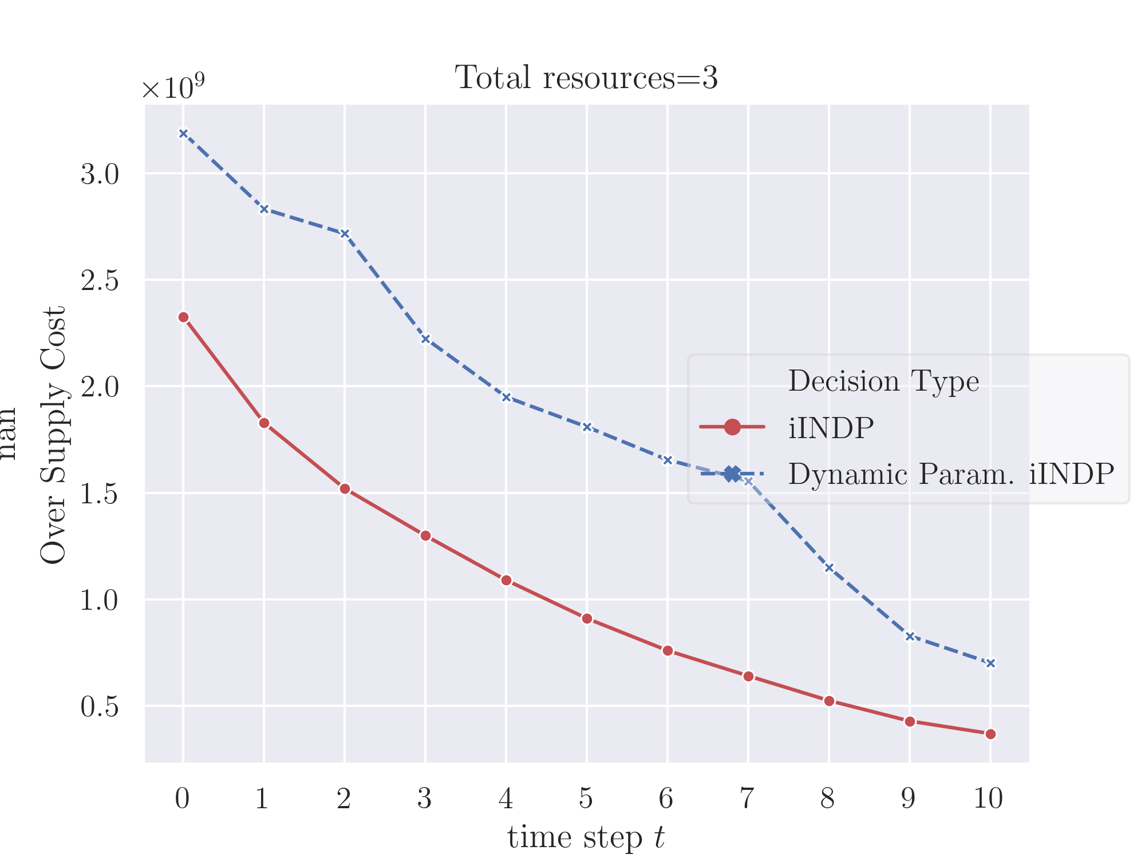
Demand and Supply Satisfaction (single scenario)

Slide 12
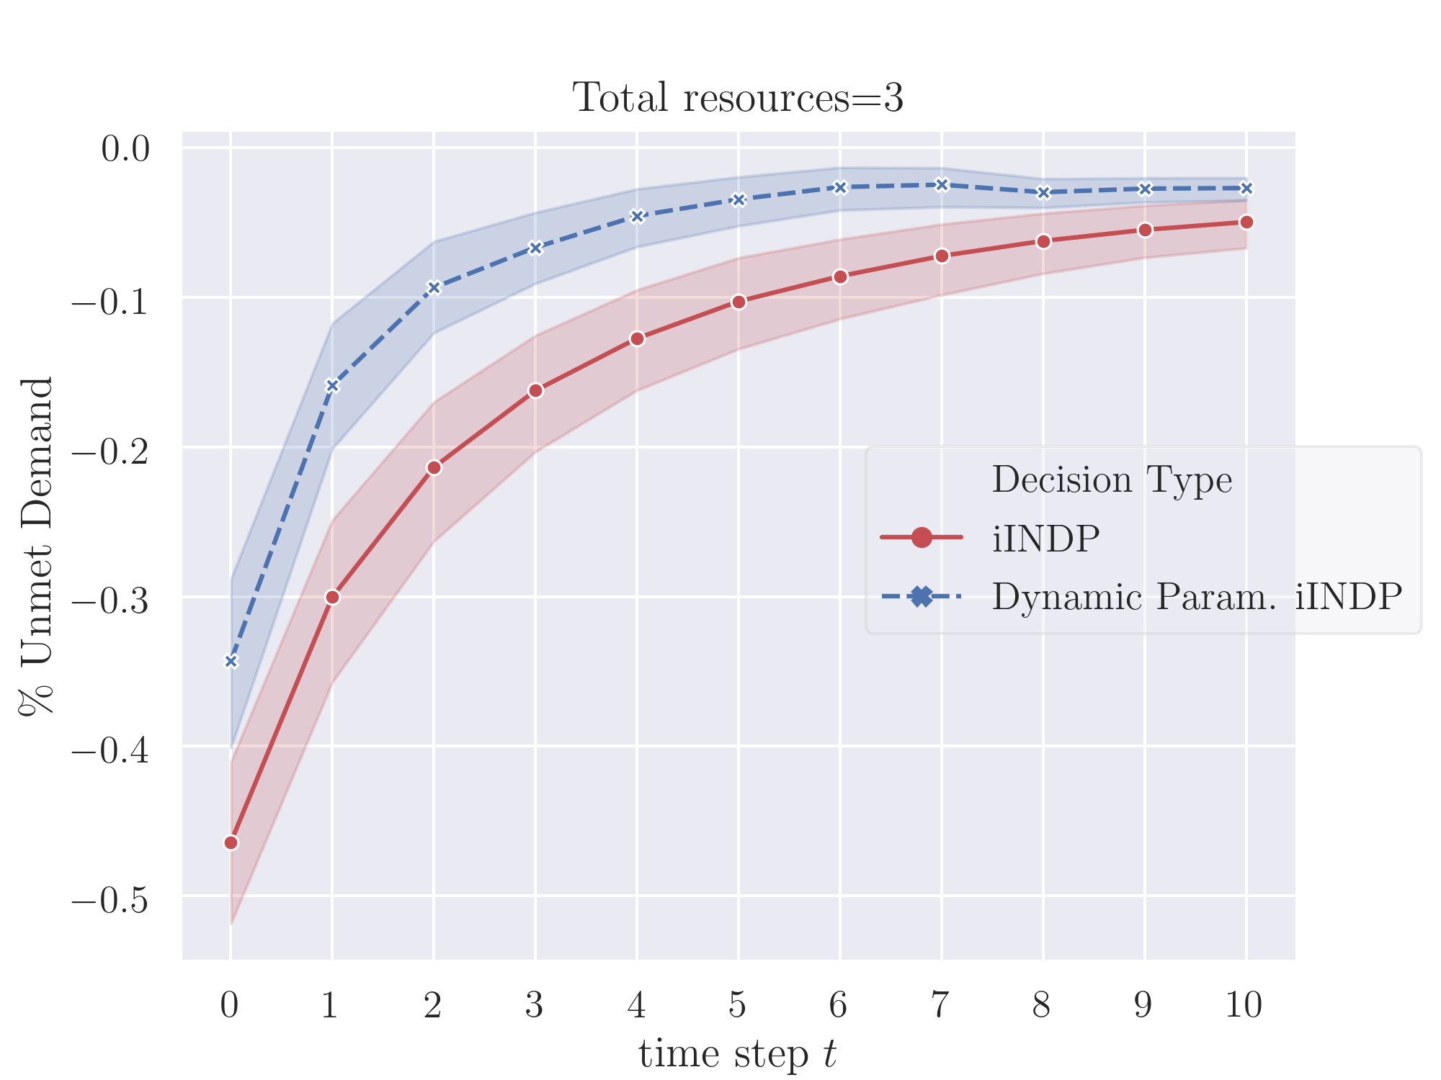
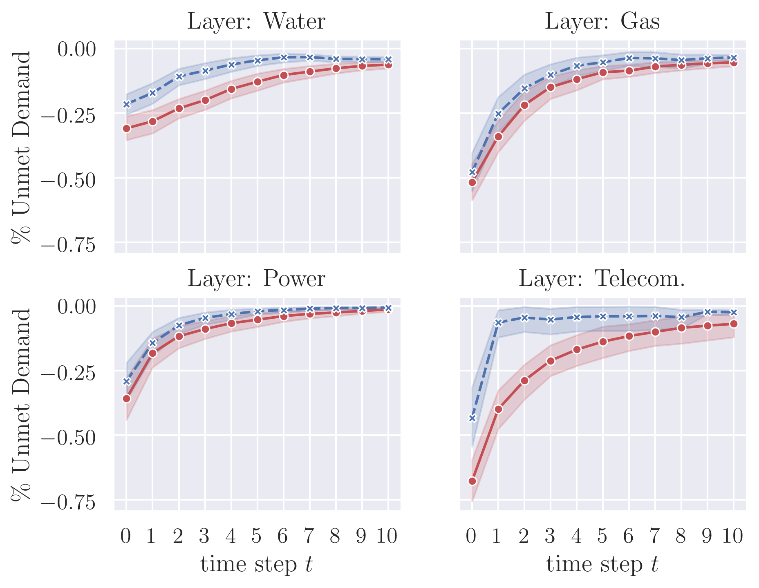
Restoration Resilience (95th–percentile scenarios)

Slide 13
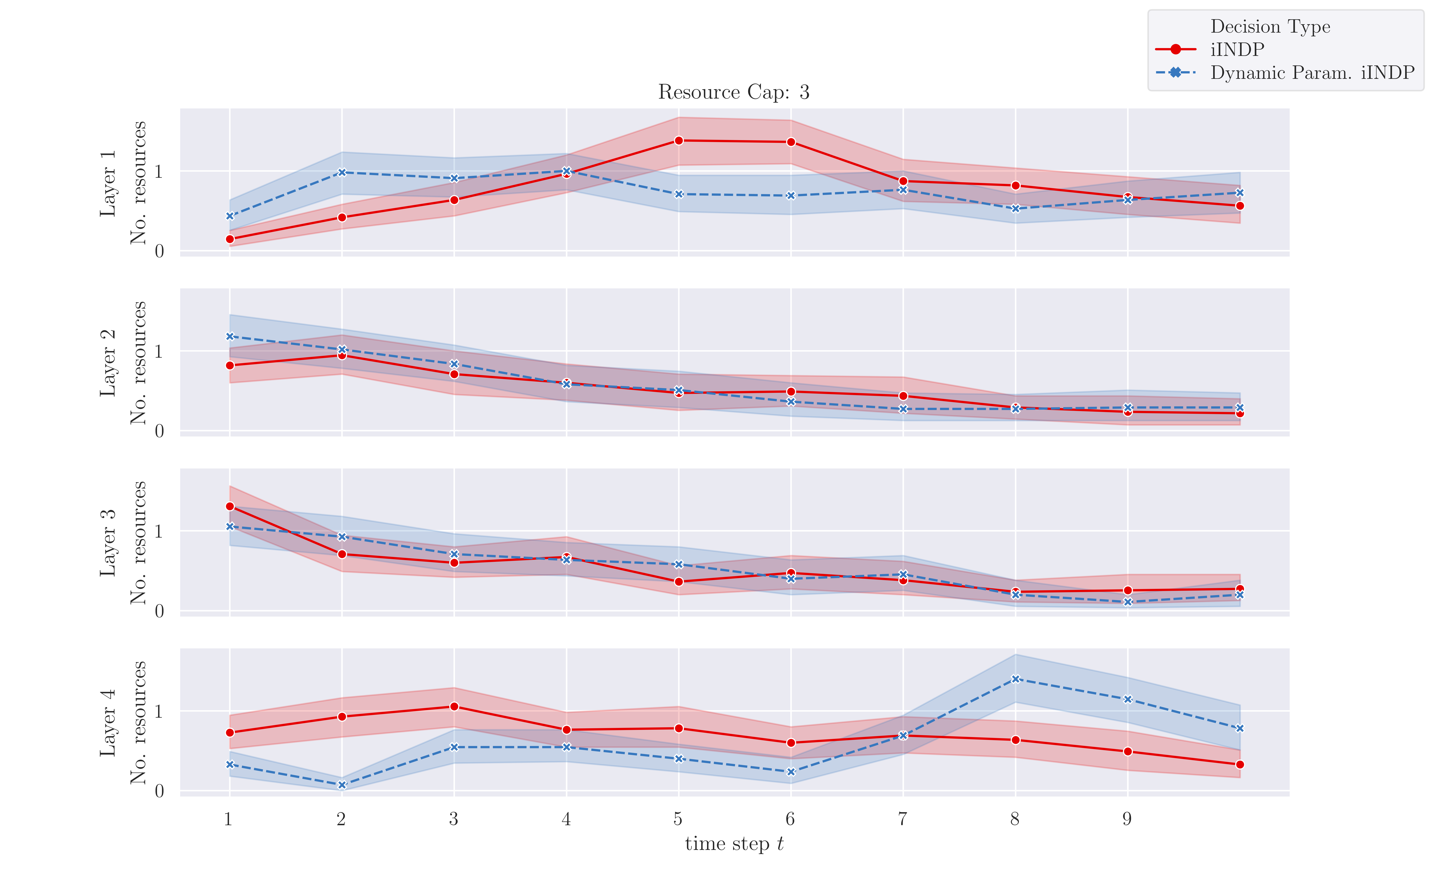
Resource Allocation (95th–percentile scenarios)

Slide 14
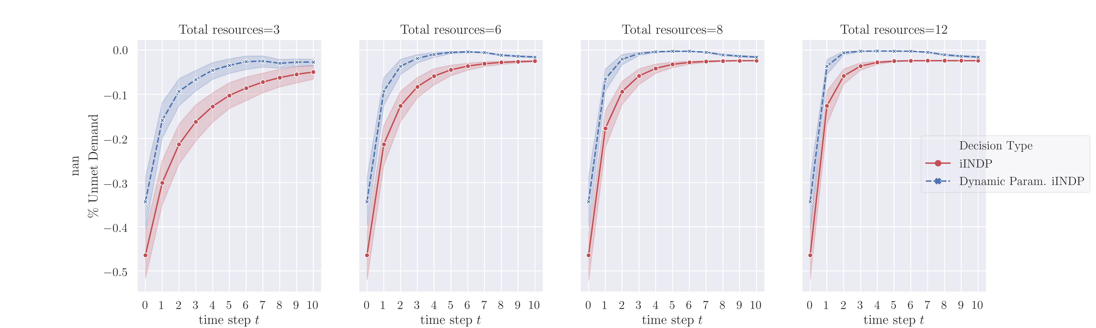
Restoration Resilience (95th–percentile scenarios)

Slide 15
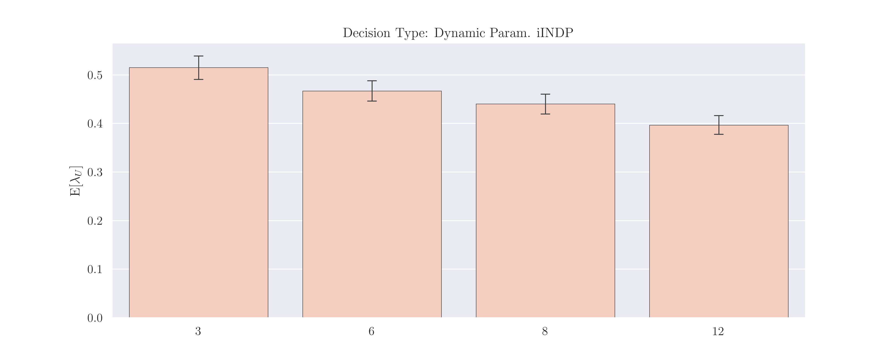
Relative Performance (95th–percentile scenarios)

Slide 16
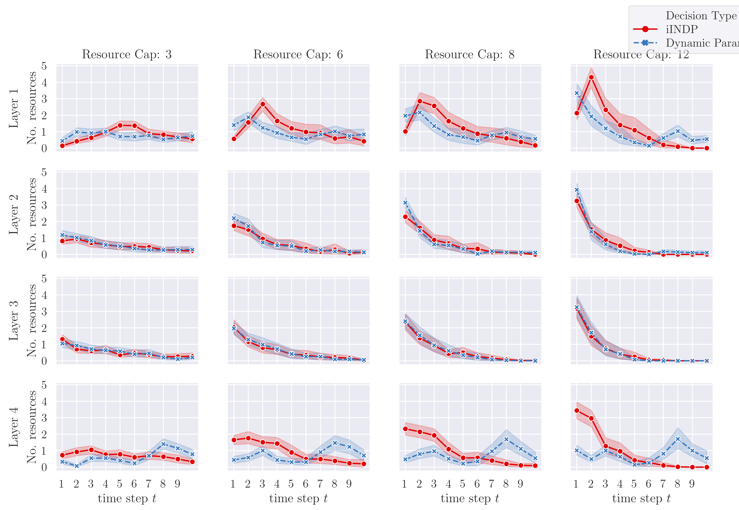
Resource Allocation (95th–percentile scenarios)

Slide 17
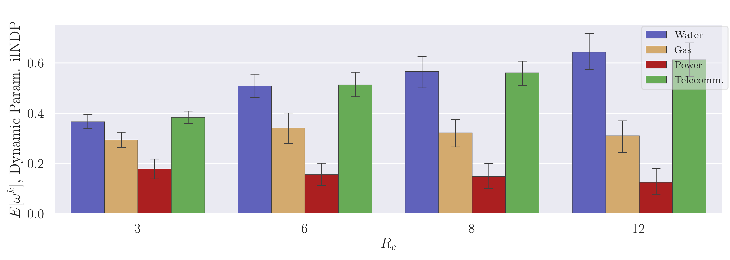
Resource Allocation Gap (95th–percentile scenarios)

